Slide 1
CSE 6339
Paper Presentation
Ismail Vandeliwala (1000990475)
03/06/2015

Slide 2
Design Challenges and Misconceptions in Named Entity Recognition
- Lev Ratinov, Den Roth 2009

Slide 3
Why NER?
Soccer – Blinker ban lifted.
London 1996-12-06 Dutch forward Reggie Blinker had his indefinite suspension lifted by FIFA on Friday and was set to make his Sheffield Wednesday comeback against Liverpool on Saturday. Blinker missed his last 2 games after FIFA slapped a worldwide ban on him for appearing to sign contracts for both Wednesday and Udinese while he was playing for Feyenoord.

Slide 4
Why NER?
Necessity of using prior knowledge and non local decisions
Need for external knowledge resources
Need for non local features
How to represent text chunks
BILOU (Beginning, Inside and Last tokens of multi-token chunks, Unit length chunks and Outside)
BIO (Begin, Inside and Outside)
What inference algorithm to use
Naïve Greedy, Viterbi, Beam Search

Slide 5
Dataset
CoNLL03 - Subset of Reuters 1996 news corpus
MUC7 – Subset of North American News Text Corpora
Webpages – Collection of 20 webpages including personal, academic and computer science conference

Slide 6
Baseline system
NER viewed as sequential prediction problem
x = (x₁.. x_{N}) be an input sequence
y = (y₁..y_{N}) be an output sequence
P(y_{i} | x_{i-k} … x_{i+l} , y_{i-m} … y_{i-1} )
y₁ is predicted based on x₁
y₂ is predicted based on x₂ and {(x₁,y₁)}
y₃ is predicted based on x₃ and {(x₁,y₁), (x₂,y₂)}
Uses regularized averaged perceptron

Slide 7
Baseline system
Features:
Previous two predictions
Current word
x_{i} word type (all capitalized, all digits, alpha numeric)
Prefix and suffix of x_{i}
Tokens in window c = (x_{i-2 ,} x_{i-1 ,} x_{i ,} x_{i+1} , x_{i+2})
Conjunction of c and y_{i-1}

Slide 8
Baseline system
Performance of different inference methods on CoNLL03 test data:
Table 1:
Algorithm | Baseline System | Final System
Greedy | 83.29 | 90.57
Beam size = 10 | 83.38 | 90.67
Beam size = 100 | 83.38 | 90.67
Viterbi | 83.71 | NA

Slide 9
Chunk Representation
Ismail is working as Teaching assistant for UTA at Arlington, Texas
BIO
Ismail (I-PER), is .. for (O), UTA (I-ORG), at (O), Arlington (B-LOC), Texas (I-LOC)
BILOU
Ismail (U-PER), is .. for (O), UTA (U-ORG), at (O), Arlington (B-LOC), Texas (L-LOC)

Slide 10
Chunk Representation
End system performance with BILOU and BIO schemes:
Rep Scheme | CoNLL03 Test | CoNLL03 Dev | MUC7 Test | MUC7 Dev
BIO | 89.15 | 93.61 | 86.76 | 85.15
BILOU | 90.57 | 93.28 | 88.09 | 85.62
Conclusion:
Choice of encoding scheme has big impact
Less used BILOU significantly outperforms the widely adopted BIO tagging scheme

Slide 11
Inference algorithm
According to table 1, greedy policy performs well
Greedy decoding is over 100 times faster than Viterbi
With BILOU, each encoding can take 21 states and hence greedy policy requires 21 comparisons
While Viterbi requires 21³ comparisons.
Beam search and Viterbi require transforming the predictions of classifiers to probabilities, incurring additional time

Slide 12
Non Local Features
Identical tokens should have identical label assignments
As per the 1st example, all the occurrences of blinker are assigned the PER label
Lets say word Australia and Bank of Australia in the same document should be assigned LOC and ORG.

Slide 13
Context Aggregation
Features:
InitCaps of Other Occurences (ICOC)
Corporate Suffixes and Person Prefixes of Other Occurrences (CSPP)
Acronyms (ACRO)
Sequence of Initial Caps (SOIC)
Unique Occurrences and Zone (UNIQ)
http://delivery.acm.org/10.1145/1080000/1072253/p25-chieu.pdf?ip=76.184.7.2&id=1072253&acc=OPEN&key=4D4702B0C3E38B35%2E4D4702B0C3E38B35%2E4D4702B0C3E38B35%2E6D218144511F3437&CFID=629194438&CFTOKEN=39710684&__acm__=1425525833_10188c4f6989e8a8cd4885a2bbeed202

Slide 14
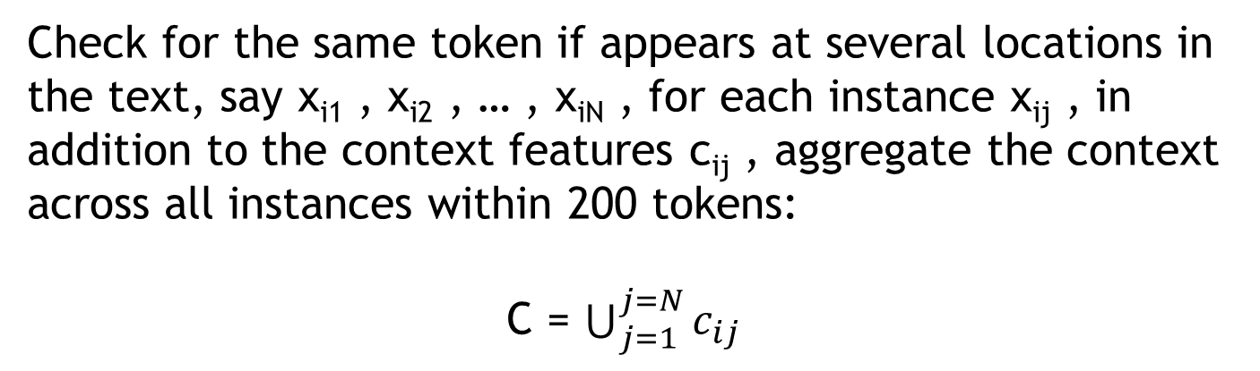
Context Aggregation
Check for the same token if appears at several locations in the text, say x_{i1} , x_{i2} , … , x_{iN} , for each instance x_{ij} , in addition to the context features c_{ij} , aggregate the context across all instances within 200 tokens:
C = $\bigcup_{j=1}^{j=N}{c_{ij}}$

Slide 15
Two Stage Prediction Aggregation
Apply baseline NER system and use the resulting predictions as features in second level of inference.
Features:
Token Majority
Entity Majority
Instead of document and corpus majority tags, use relative frequency of tags in 1000 token window

Slide 16
Extended Prediction History
When we are making predictions for token instance x_{i} , we have already made predictions y₁ , … , y_{i-1} for token instance x₁ , … , x_{i-1}
When making prediction for token instance x_{i} , we record the label assignment distribution for all token instances for the same token type in previous 1000 words.
If token instance is “Australia” and in previous 1000 tokens, the token type “Australia” was twice assigned the label L-ORG and three times the label U-LOC, then the prediction history feature will be: L-ORG: 2/5, U-LOC: 3/5

Slide 17
External Knowledge – Unlabeled Text
Related to word class models
Hierarchically cluster words, producing a binary tree
Friday Monday Thursday
June March July April
people guys folks fellows CEOs
down backwards ashore sideways southward northward
water gas coal liquid acid

Slide 18
External Knowledge – Gazetteers
Gazetteers – dictionary look up
Example:
“Rare Jimi Hendrix song draft sells for almost $17,000”
Convert candidate word name to Wikipedia entity name – Jimi_Hendrix and retrieve the article.
Wikipedia tag is B-guitarist and NE tag is B-PER
Used total 30 gazetteers

Slide 19
Local and Global Algorithms for Disambiguation to Wikipedia
- Lev Ratinov, Dan Roth, Dough Downey, Mike Anderson (2011)

Slide 20
Introduction
Disambiguation refers to the removal of ambiguity by making something clear.
Wikification is the task of identifying and linking expressions in text to their referent Wikipedia pages
For example, given the input sentence “I am visiting friends in <Chicago>, the output should be “http://en.wikipedia.org/wiki/Chicago

Slide 21
Problem Definition
Document d with a set of mentions M = {m1, …, mN}
Produce mapping from the set of mentions to the set of Wikipedia titles W = {t1, …, tW}
Some mentions might corresponds to a concept without Wikipedia page which is recognized by adding null title to the set W
D2W (Disambiguation to Wikipedia) task can be visualized as finding a many-to-one matching on a bipartite graph

Slide 22
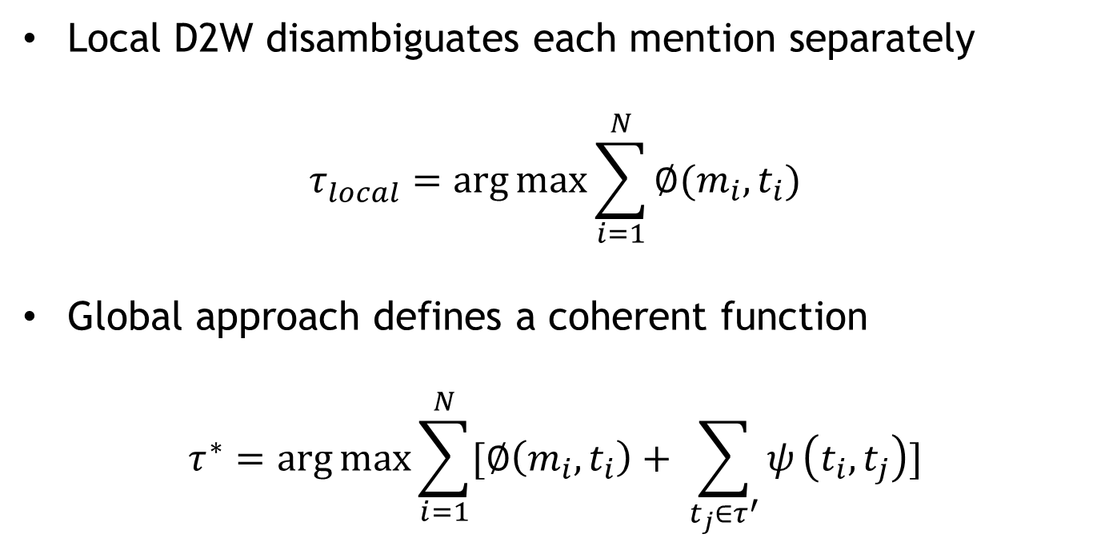
Local and global disambiguation
Local D2W disambiguates each mention separately
$$τ_{local}^{}=\arg{\max{\sum_{i=1}^{N}{∅(m_{i},t_{i})}}}$$
Global approach defines a coherent function
$$τ^{∗}=\arg{\max{\sum_{i=1}^{N}{[∅\left(m_{i},t_{i}\right)+ \sum_{t_{j}∈τ^{′}}{ψ}}}}\left(t_{i},t_{j}\right)]$$

Slide 23
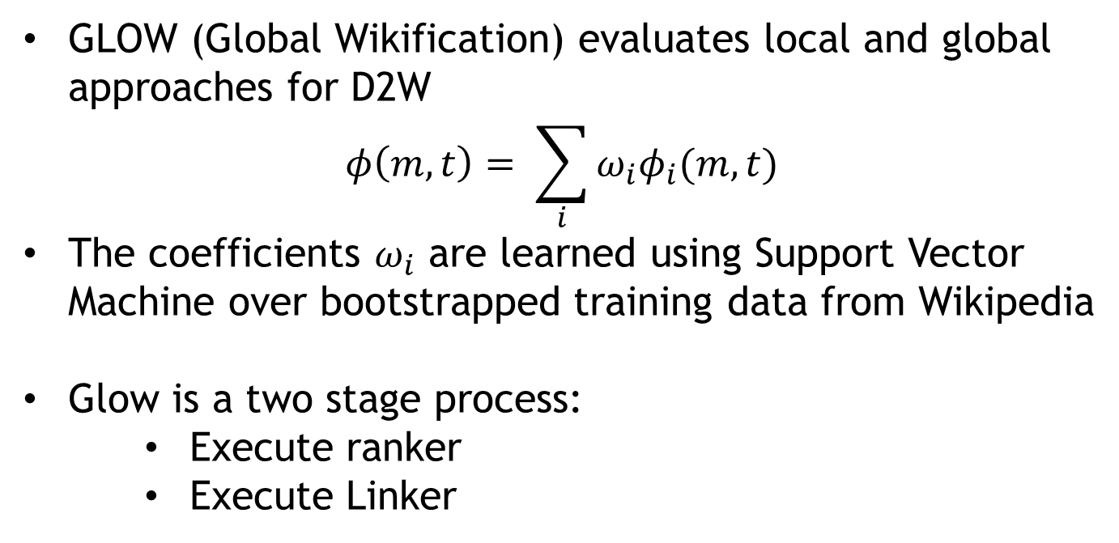
GLOW Architecture
GLOW (Global Wikification) evaluates local and global approaches for D2W
$$φ\left(m,t\right)= \sum_{i}{ω_{i}φ_{i}(m,t)}$$
The coefficients $ω_{i}$ are learned using Support Vector Machine over bootstrapped training data from Wikipedia
Glow is a two stage process:
Execute ranker
Execute Linker

Slide 24
GLOW Algorithm
Given document d and set of mentions M
Augment the set of mentions with all phrases in the document that could be linked to Wikipedia but were not included in M
For each mention m_{i} , construct a limited set of Wikipedia titles T_{i}
Ranker outputs the most appropriate non null disambiguation t_{i} for each mention m_{i}
Linker decides whether the top-ranked disambiguation is correct

Slide 25
Disambiguation candidate generation
GLOW uses anchor-title index computed by crawling Wikipedia that maps each distinct hyperlink anchor text to its target Wikipedia titles.
Query anchor title index for given mention to retrieve disambiguation candidates.
Compute 2 local features:
P(t|m): Fraction of times the title t is the target page for an anchor text m.
P(t): Fraction of all the Wikipedia articles that link to t

Slide 26
Local Features
It captures the intuition that given Wikipedia title t is more likely to be referred to by mention m appearing in a document d if the Wikipedia page for t has high textual similarity to d, or if the context surrounding hyperlinks to t are similar to m’s context in d
Text(t) – top 200 token TF-IDF summary of the Wikipedia page t
Context(t) – top 200 token TF-IDF summary of the context within which t was hyperlinked to in Wikipedia
Text(m) – TF-IDF representation of document d
Context(m) – TF-IDF representation of a 100-token window around m

Slide 27
Local Features
Naïve / Re-weighted:
Cosine-sim(Text(t),Text(m))
Cosine-sim(Text(t),Context(m))
Cosine-sim(Context(t),Text(m))
Cosine-sim(Context(t),Context(m))

Slide 28
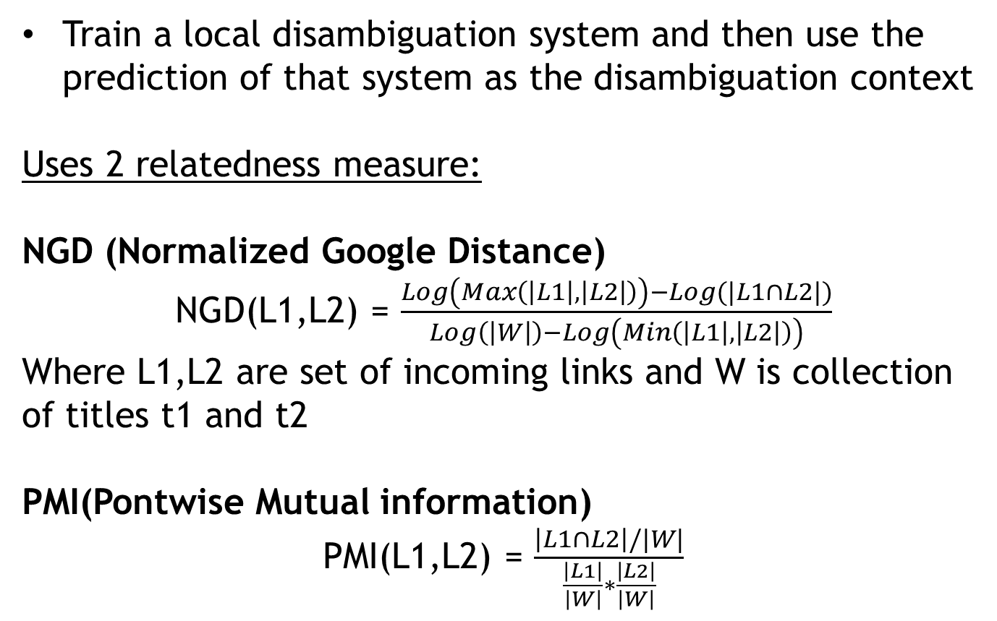
Global Features
Train a local disambiguation system and then use the prediction of that system as the disambiguation context
Uses 2 relatedness measure:
NGD (Normalized Google Distance)
NGD(L1,L2) = $\frac{Log\left(Max\left(\left|L1\right|,\left|L2\right|\right)\right)−Log(|L1∩L2|)}{Log\left(\left|W\right|\right)−Log\left(Min\left(\left|L1\right|,\left|L2\right|\right)\right)}$
Where L1,L2 are set of incoming links and W is collection of titles t1 and t2
PMI(Pontwise Mutual information)
PMI(L1,L2) = $\frac{\left|L1∩L2\right|/|W|}{\frac{\left|L1\right|}{\left|W\right|}∗\frac{\left|L2\right|}{\left|W\right|}}$

Slide 29
Global Features
Rather than taking sum of the relatedness score for function shown in slide 3, two features average and maximum are used.
Average is expected to give more information for many documents.
PMI(InLinks(t_{i}),InLinks(t_{j}))
NGD(InLinks(t_{i}),InLinks(t_{j}))
PMI(OutLinks(t_{i}),OutLinks(t_{j}))
NGD(OutLinks(t_{i}),OutLinks(t_{j}))

Slide 30
Linker Features
Given the mention m and top ranked disambiguation t, the linker attempts to decide whether t is indeed the correct disambiguation of m.
Properties that can be included:
The confidence of ranker in t with respect to second best disambiguation
The percent of Wikipedia titles in which m appears hyperlinked versus the percent of times m appears as plain text
Whether m was detected by NER as named entity
How likely m is out of Wikipedia concept based on the counts in P(t|m)

Slide 31
Dataset
AQUAINT - Subset of AQUAINT corpus of newswire text
MSNBC – News data and focus on disambiguating named entities after running NER
ACE – Automatic Content Extraction data which has advantage that their mentions are given
Wiki – Sample of paragraphs from Wikipedia pages. Mentions in this data corresponds to existing hyperlinks in Wikipedia text.

Slide 32
Results:
System | ACE | MSNBC | AQUAINT | Wiki
Baseline: P(t|m) | 69.52 | 72.83 | 82.67 | 81.77
GLOW Local | 75.60 | 74.39 | 84.52 | 90.20
GLOW Global | 74.73 | 74.58 | 84.37 | 86.62
GLOW | 77.25 | 74.88 | 83.94 | 90.54
M&W | 72.76 | 68.49 | 83.61 | 80.32

Slide 33
References:
http://www.ai.mit.edu/courses/6.867-f04/lectures/lecture-13-ho.pdf
http://en.wikipedia.org/wiki/Web_crawler
http://en.wikipedia.org/wiki/WebCrawler

